Slide 1

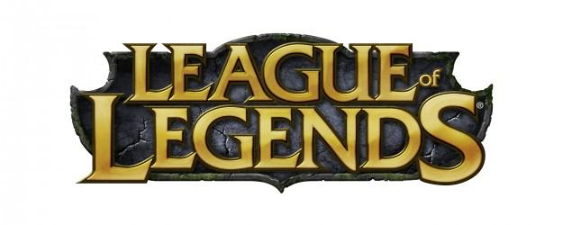

League of Legends Item Balancing Recommendations
Sebastian Alvis
25 April 2019
PuPPy: Scientific Computing Night

Slide 2
Who I am
Sebastian Alvis
Bachelor’s in Physics from UIUC
Master’s in Physics from UW
Springboard Data Science Bootcamp
This presentation is my first capstone project
https://github.com/salvis2/SpringboardAlvis/tree/master/capstone_project_1
If you want to ask me anything
Find me on LinkedIn
Or send me an email at sebialvis@gmail.com

Slide 3
Outline
Crash Course: League of Legends
Problem Statement
Data
Statistics
Machine Learning
Conclusions

Slide 4
Outline
Crash Course: League of Legends
Problem Statement
Data
Statistics
Machine Learning
Conclusions

Slide 5
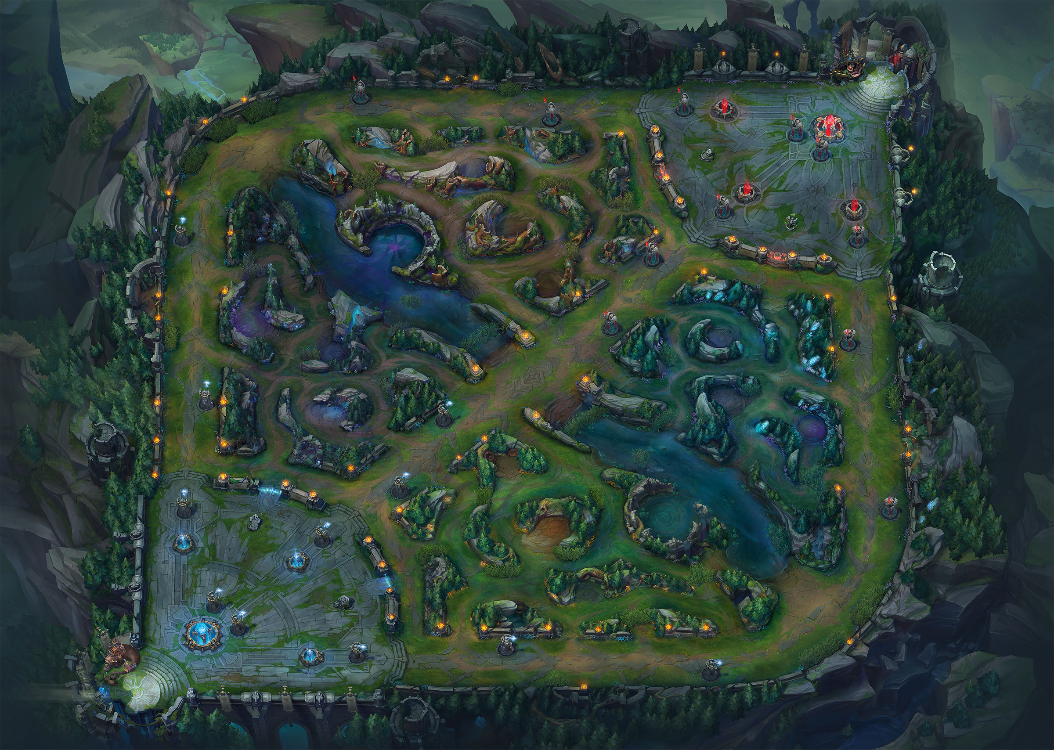
League of Legends: The Map
Summoner’s Rift
5 players vs 5 players
Both teams have bases
3 Lanes
Area between lanes is the Jungle
Top Lane
Mid Lane
Bot Lane

Slide 6
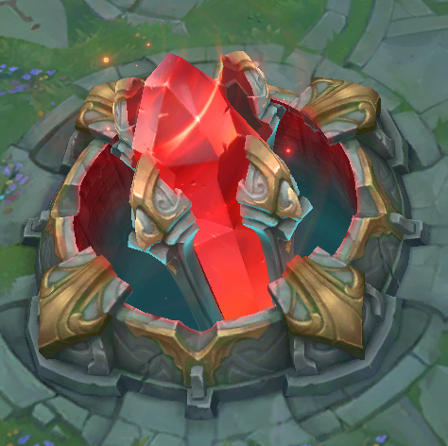
League of Legends: The Objective
Objective: Destroy the Nexus
Red Base Nexus
Blue Base Nexus

Slide 7

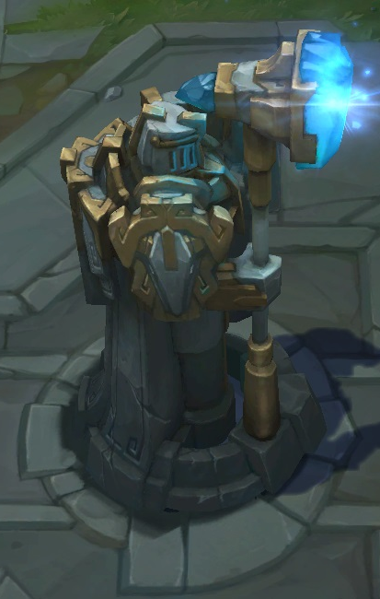
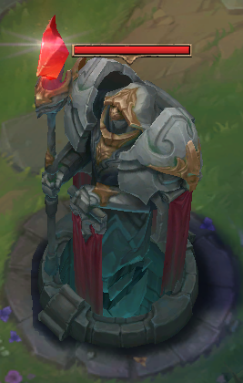
League of Legends: Towers
Block the lanes
Shoot enemy champions
Shoot enemy minions

Slide 8
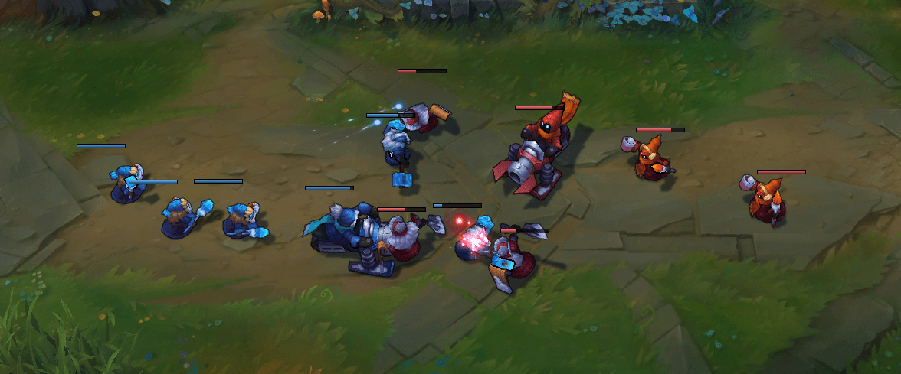
League of Legends: Minions
Spawn in every lane
Attack enemy units in front of them
Help get through turrets
Red Base Nexus
Blue Base Nexus

Slide 9










League of Legends: Champion and Teams
Blue Team Name (Role) | Position | Red Team Name (Role)
Riven (Fighter) | Top Lane | Sion (Tank)
Jarvan IV (Tank) | Jungle | Sejuani (Tank)
Syndra (Mage) | Mid Lane | Lux (Mage)
Tristana (Marksman) | AD Carry (Bot Lane) | Twitch (Marksman)
Brand (Mage) | Support (Bot Lane) | Rakan (Support)
Each champion has unique abilities
Starting map positions for champions
Maximize team gold
Various roles / archetypes for champions
Assassin, Fighter, Mage, Marksman, Support, Tank
Archetype generally determines the kinds of items you buy
Notes:
Tristana has 0.656 attack speed at level 1 (gets an attack off every 1.52s)
Her Q gives her 50% attack speed.

Slide 10
League of Legends: Playing the Game
Objective: Destroy the Nexus
Make your champion stronger
Level up
Buy items
Fighting various enemies provides gold and experience

Slide 11
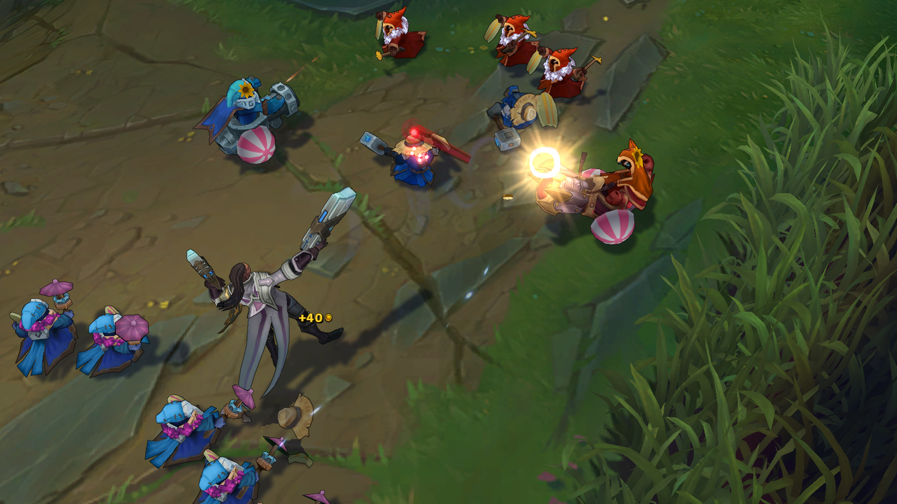
League of Legends: Playing the Game
Objective: Destroy the Nexus
Fighting various enemies provides gold and experience
Enemy minions

Slide 12
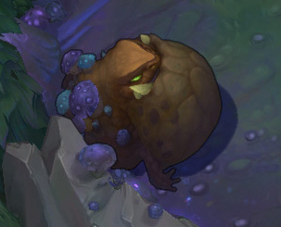
League of Legends: Playing the Game
Objective: Destroy the Nexus
Fighting various enemies provides gold and experience
Enemy minions
Jungle monsters

Slide 13
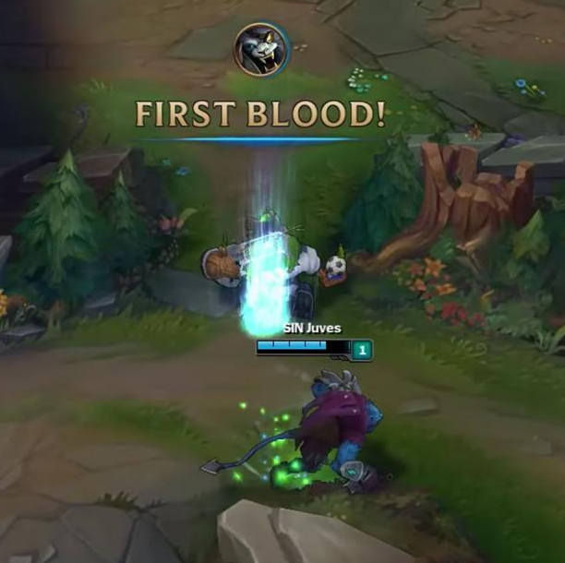
League of Legends: Playing the Game
Objective: Destroy the Nexus
Fighting various enemies provides gold and experience
Enemy minions
Jungle monsters
Enemy champions

Slide 14
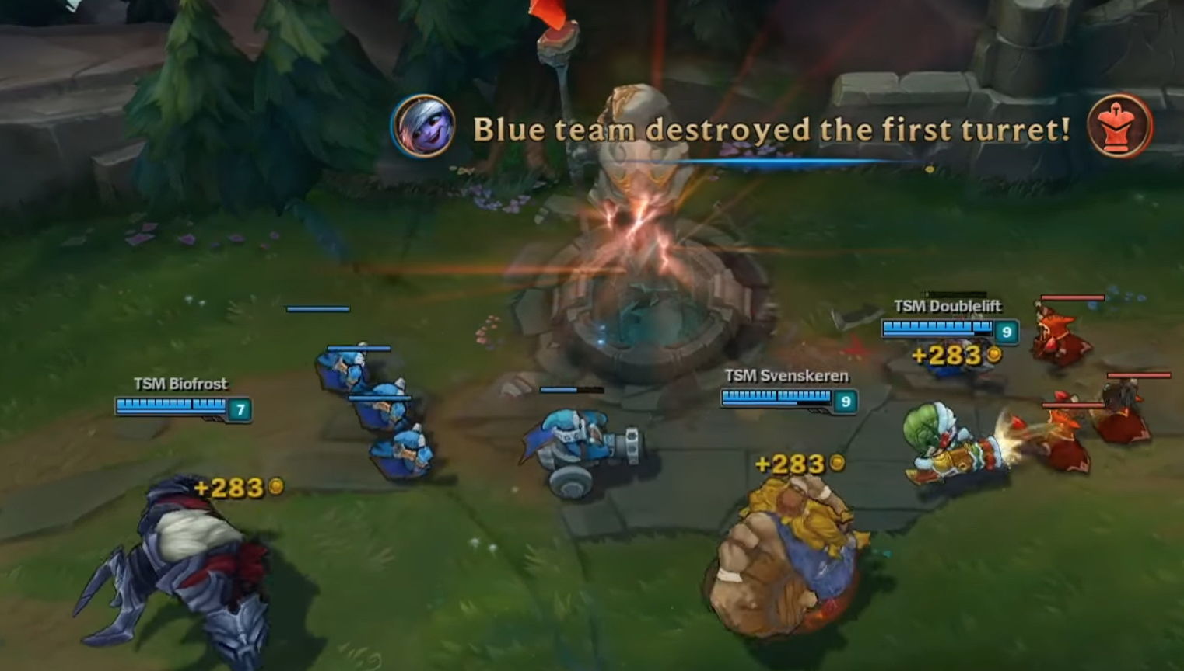
League of Legends: Playing the Game
Objective: Destroy the Nexus
Fighting various enemies provides gold and experience
Enemy minions
Jungle monsters
Enemy champions
Towers

Slide 15
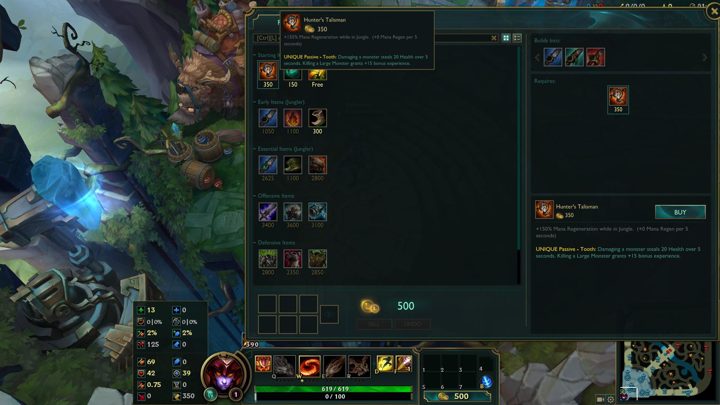
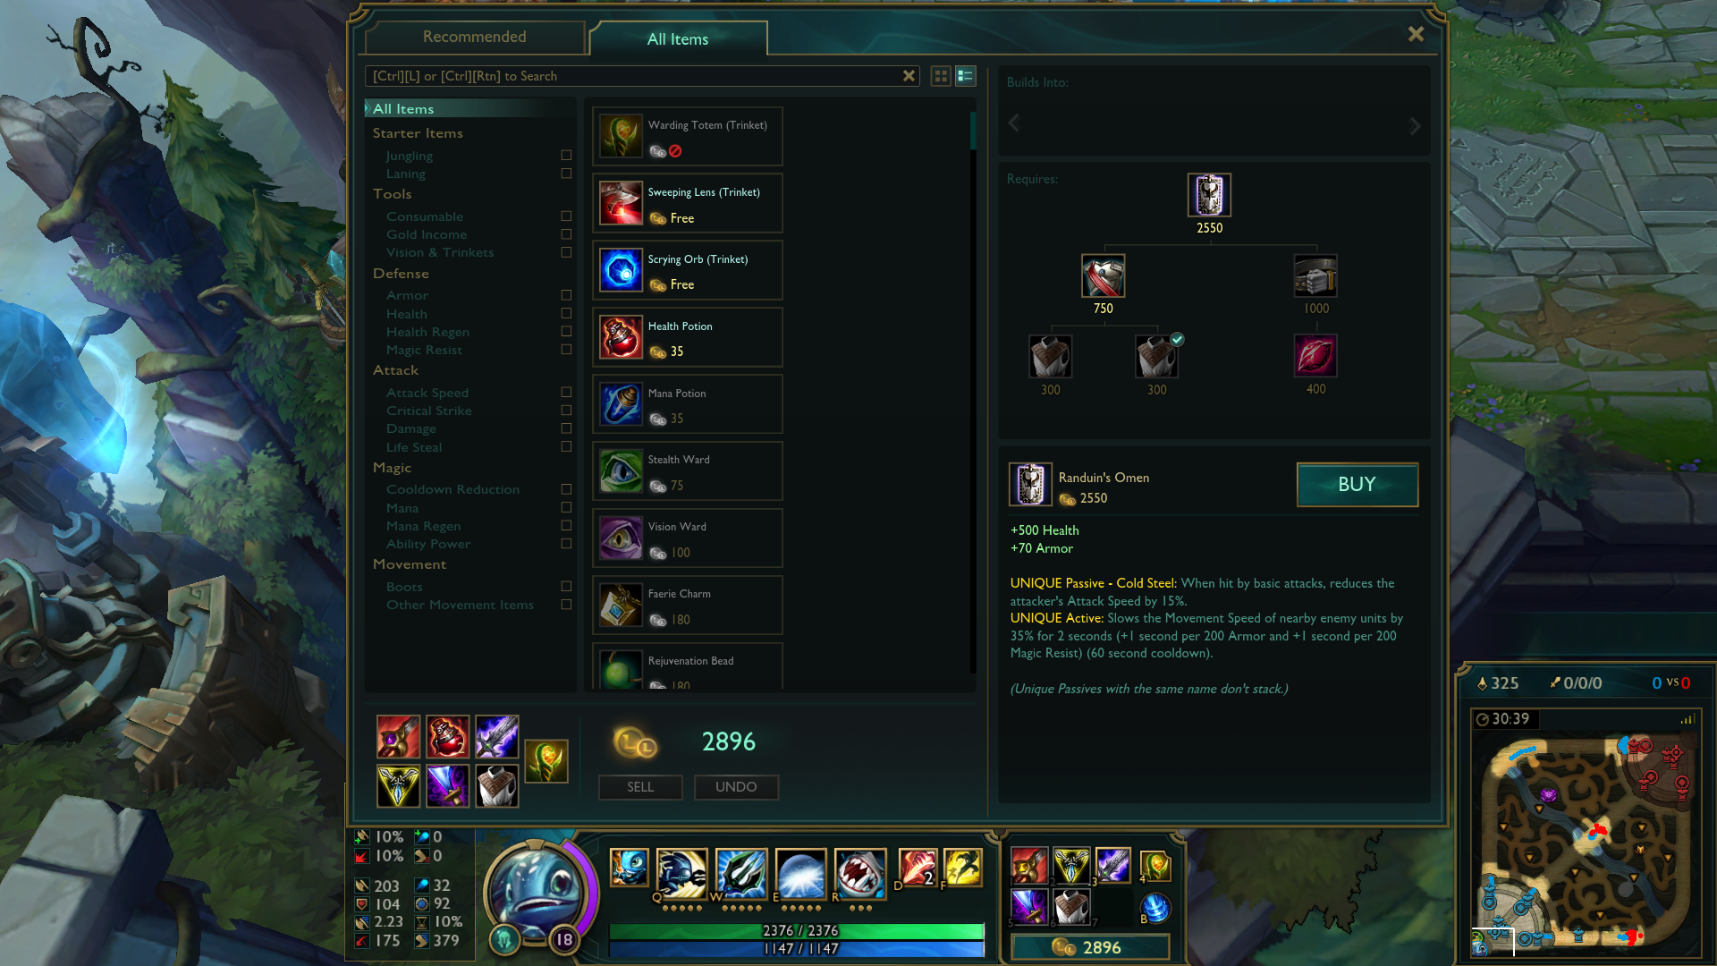
League of Legends: Playing the Game
Objective: Destroy the Nexus
Fighting various enemies provides gold and experience
Leveling up improves abilities
Items upgrade various attributes of the champion

Slide 16
Outline
Crash Course: League of Legends
Problem Statement
Data
Statistics
Machine Learning
Conclusions

Slide 17
Why should you change the game at all?
League of Legends currently has
143 champions
200+ items
Diversity is it’s strong suit
Nobody wants to see the same champions and items every game
Game balance causes different champions and items to show up
More interesting gameplay
Notes:
The two big pillars to balance are champions and items
But I’ve been to so many websites that talk about win rates etc for champions
I felt like I’ve seen that analysis before, so I don’t want to redo it

Slide 18
Problem Statement
How do you know when you should change an item?

Slide 19
Outline
Crash Course: League of Legends
Problem Statement
Data
Statistics
Machine Learning
Conclusions

Slide 20
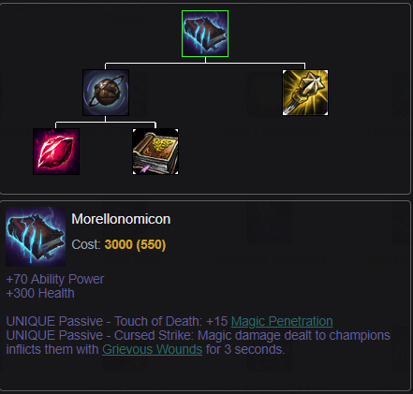
“Static” Data
Acquired through the Riot Games Static API
Items
Champions
JSON files
It is consistent data
Static
Patches can tweak champions / items
“Static”

Slide 21

Match Data
Taken from the Ranked Queue
People take the game more seriously
Only higher-level Leagues: Diamond and Platinum
People have more game knowledge and experience
1000 random players
1000 random matches
Match data
Game state at the end of the game

Slide 22
Dataframes
Items
Champions
Matches
Item Statistics
Win Rate
Pick Rate

Slide 23
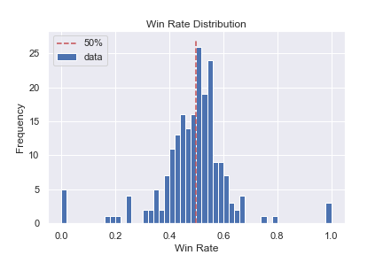
Item Stats: Win Rate
# of occurrences with a win /
# of occurrences
Bernoulli variable
Easy Interpretation
Avg: 0.50

Slide 24
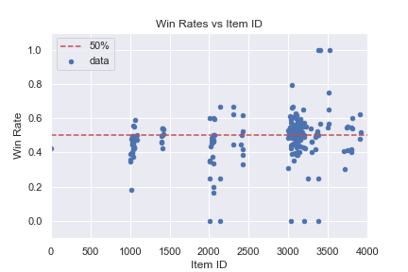
Item Stats: Win Rate
# of occurrences with a win /
# of occurrences
Bernoulli variable
Easy Interpretation
Avg: 0.50

Slide 25
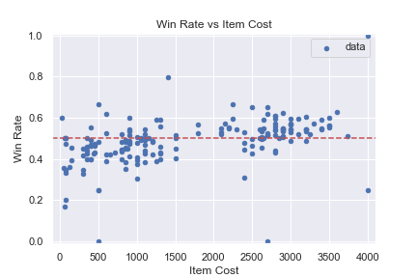
Item Stats: Win Rate vs Item Cost
This shows that finishing an item is good for your chances of winning
The final analysis will use mostly the right lobe
Focusing on full items and which ones are too strong / weak

Slide 26
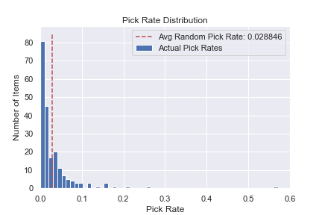
Item Stats: Pick Rate
How often an item is bought
A metric of popularity
Popularity often indicates what is strong
This helps us when win rate can’t
Also pretty easy to understand

Slide 27
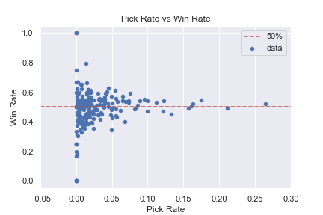
Pick Rate vs Win Rate
Higher pick rate
Closer to the mean
This drags the win rate to 50%

Slide 28
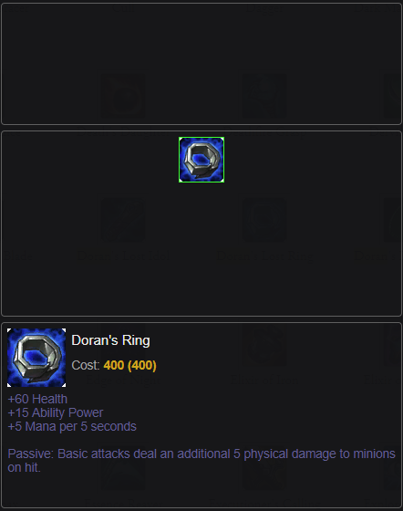
Final Item Dataset
There are 200+ items in League
I don’t want to look at all of them
Remove
Starting items

Slide 29
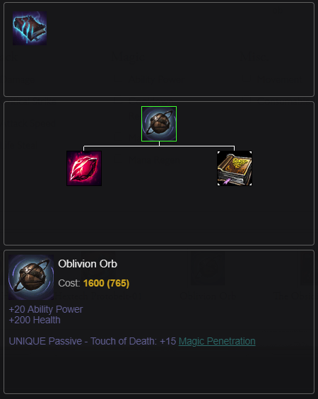
Final Item Dataset
There are 200+ items in League
I don’t want to look at all of them
Remove
Starting items
Incomplete items

Slide 30
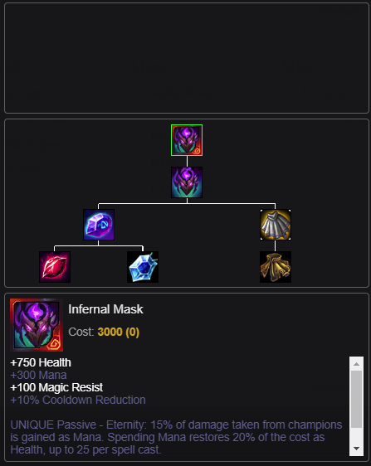
Final Item Dataset
There are 200+ items in League
I don’t want to look at all of them
Remove
Starting items
Incomplete items
Items with fewer than 10 occurrences

Slide 31
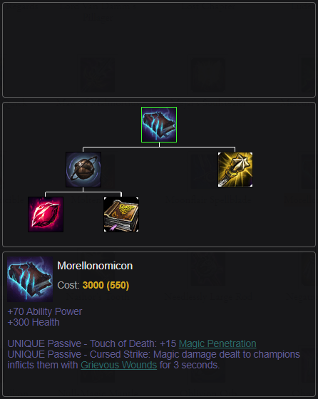
Final Item Dataset
There are 200+ items in League
I don’t want to look at all of them
Remove
Starting items
Incomplete items
Items with fewer than 10 occurrences
Resultant table has 80 items

Slide 32
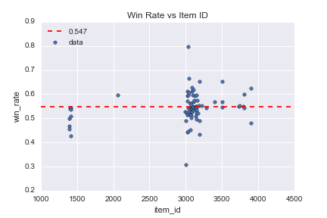
Final Item Win Rates
# of occurrences with a win /
# of occurrences
Bernoulli variable
Easy Interpretation
Weighted Avg: 0.547

Slide 33
Outline
Crash Course: League of Legends
Problem Statement
Data
Statistics
Machine Learning
Conclusions

Slide 34
Statistics: Abnormal Win Rates
Win rate is Bernoulli
Easy to estimate a sample std
Avg: 0.547
95% Confidence Interval for each items’ win rate
Abnormal Items:
Items where the mean isn’t inside the 95% CI

Slide 35
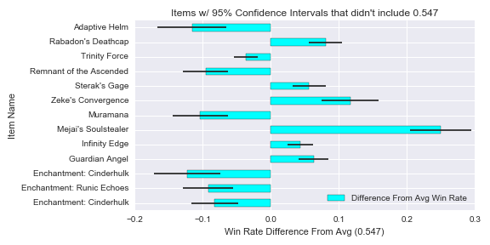
Statistics: Abnormal Win Rates

Slide 36
Statistics: Abnormal Win Rates

Slide 37
Statistics: Junglers
Blue Team Name (Role) | Position | Red Team Name (Role)
Riven (Fighter) | Top Lane | Sion (Tank)
Jarvan IV (Tank) | Jungle | Sejuani (Tank)
Syndra (Mage) | Mid Lane | Lux (Mage)
Tristana (Marksman) | AD Carry (Bot Lane) | Twitch (Marksman)
Brand (Mage) | Support (Bot Lane) | Rakan (Support)
‘Enchantments’ belong to the Jungle Item Group

Slide 38
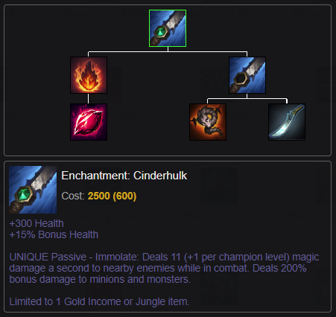
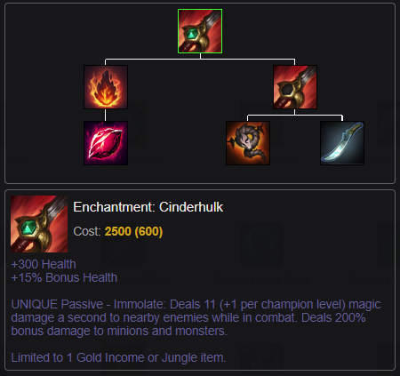
Statistics: Jungle Items

Slide 39
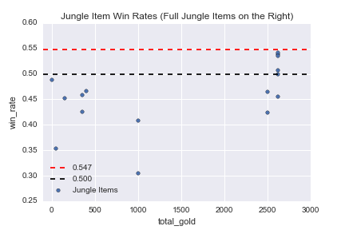
Statistics: Jungle Items
Win Rate is not centered around 54.7% like the rest of the items
Win Rate should be centered around 50%

Slide 40
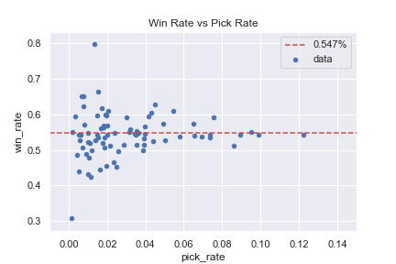
Statistics: Win Rate Noise
Item picked once on each side
Win rate is 0.50
Not informative
Win rate drifts towards 0.50
“Masking”

Slide 41
Statistics: Win Rate Noise
Item picked once on each side
Win rate is 0.50
Not informative
Win rate drifts towards 0.50
“Masking”
Blue Team Name (Role) | Position | Red Team Name (Role)
Riven (Fighter) | Top Lane | Sion (Tank)
Jarvan IV (Tank) | Jungle | Sejuani (Tank)
Syndra (Mage) | Mid Lane | Lux (Mage)
Tristana (Marksman) | AD Carry (Bot Lane) | Twitch (Marksman)
Brand (Mage) | Support (Bot Lane) | Rakan (Support)

Slide 42
Statistics: Unmask Win Rates
Loop for each item
Find how many more one team built than the other
Track the number of wins and total games from that difference
Ex:
Team 1 builds 3 Morellonomicons and Loses
Team 2 builds 1 Morellonomicon and Wins
The loop only counts 2 games for Morellonomicon
Both losses

Slide 43
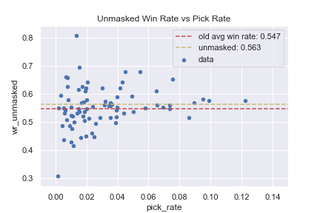
Statistics: Unmasked Win Rates
Before Unmasking
After Unmasking
Notes:
Unmasked win rate for Empty Item Slot is 0.25

Slide 44
Statistics: Abnormal Win Rates

Slide 45
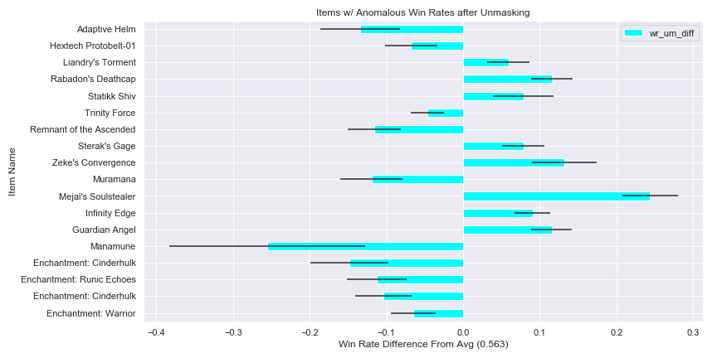
Statistics: Abnormal Win Rates 2.0
Same analysis as before, but with new win rates and counts

Slide 46
Statistics: Results
Two sets of items with anomalous win rates
Items that seem too powerful
Items that seem too weak
18 items with anomalous win rates out of 80
5 items were found to be anomalous only after unmasking
4 items are jungle items, so maybe I let them slide

Slide 47
Outline
Crash Course: League of Legends
Problem Statement
Data
Statistics
Machine Learning
Conclusions

Slide 48
Machine Learning: Considerations
Item ID is a bad variable to use
Numeric, but
The number is meaningless
Make it categorical?
Considered using
Item Costs
Different slices of an inventory
Item statistics (win rate, pick rate)
The potential for correlations is high
Danger

Slide 49
Machine Learning: Random Forests
Basic Random Forest on win/loss and item ID
Accuracy of 0.53
Essentially guessing the mean
Garbage
GridSearch with 5-fold CV
Accuracy of 0.53 as well
This model has so little data
No wonder it can’t do anything
win item_id
0 False 3020
1 False 3117
2 False 1416
3 False 3020
4 False 3078

Slide 50
Machine Learning: Considerations
A single inventory isn’t a good predictor
I’m not using timing data right now
Needs a sort of normalization
Solution: Team-Wide Item Differences
See how many of each item an entire team has
Compare that to the other team
Similar to my process for unmasking
Fixes the masking problem
Takes into account that LoL is a team game

Slide 51
Machine Learning: Feature Generation
Row for each game
Column for each item ID (including 0, Empty Item Slot)
Value is the # of that item team 1 has – the # of that item team 2 has
Positive values indicate team 1 has more of the item
Negative values indicate team 2 has more of the item
0 indicates that same number of them item on both teams
 | 1402 | 1412 | 3027 | 3068 | 3069 | 3071 | 3092 | 3100 | 3153 | 3157 | 3285 | 3504 | 3800 | 3814 | 0
8 | 1.0 | -1.0 | -1.0 | -1.0 | 1.0 | -1.0 | -1.0 | -1.0 | -1.0 | 1.0 | 1.0 | -1.0 | -1.0 | -1.0 | 3.0
Predictor is the match result: 0 or 1

Slide 52
Machine Learning: Random Forests 2.0
Basic Random Forest Classifier
Features: ‘auto’
n_estimators: 10
Accuracy: 0.69
Best RF from Grid Search with 5 – fold CV
Features: ‘auto’ (really it was 81)
n_estimators: 50
Accuracy: 0.73

Slide 53
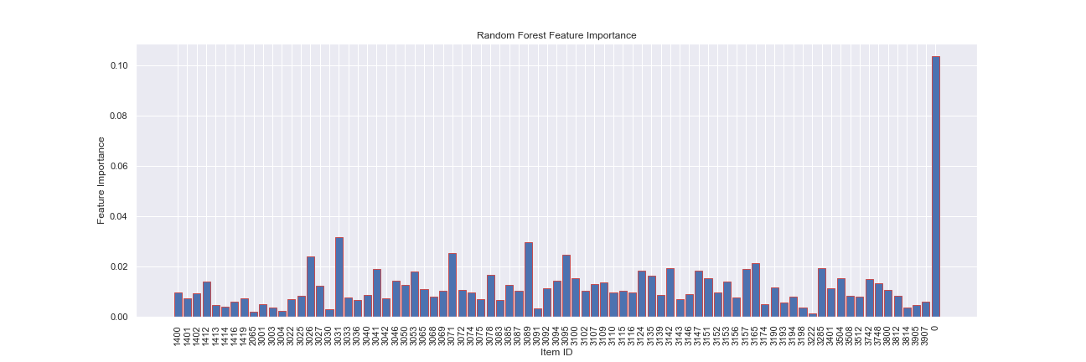
Machine Learning: Random Forests 2.0
Random Forest chose to have each column be a feature
Each item is a feature!
Easy to interpret? Kind of

Slide 54
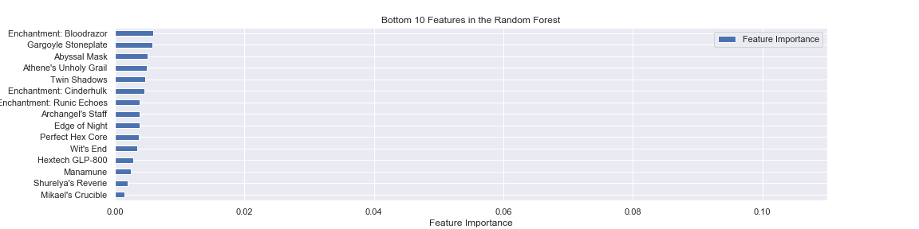
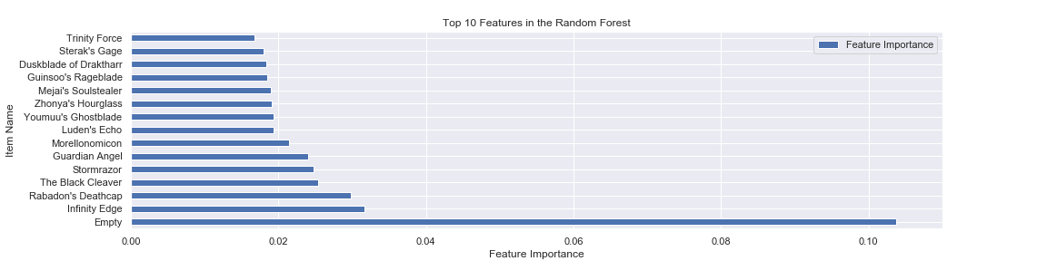
Machine Learning: Random Forests 2.0
I can find the most and least important features
But what do they mean?

Slide 55
Machine Learning: Logistic Regression
Use the same data
Advantages over Random Forests
Easier to interpret
Naturally focuses on binary predictions
Should be more accurate

Slide 56
Machine Learning: Logistic Regression
Basic Logistic Regression
L2 Penalty
Penalty Normalization C: 1.0
Training Accuracy: 0.92
Test Accuracy: 0.89
Huge Improvements over Random Forests
Grid Search Returned the same parameters as the default LR

Slide 57
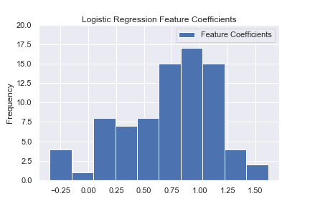
Machine Learning: Logistic Regression
Feature Coefficients
Higher numbers == Higher chance of winning
Lower numbers == Lower chance of winning
A few coefficients below 0…
Only a few very high
Potential Anomalies!

Slide 58
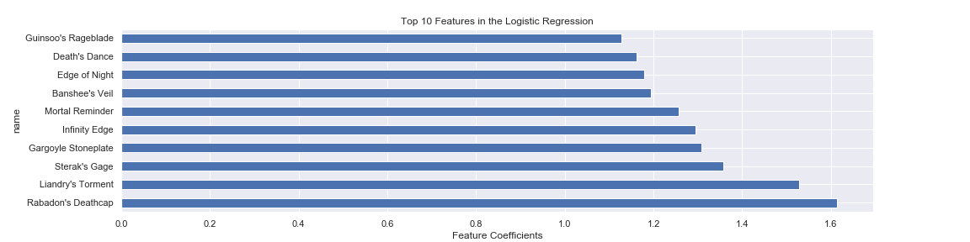
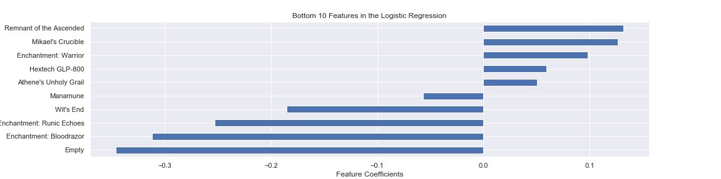
Machine Learning: Logistic Regression
Which items have good coefficients? Bad?

Slide 59
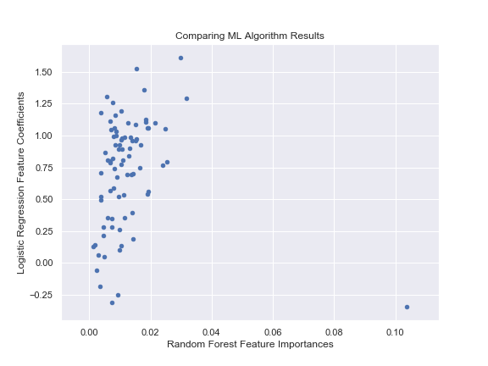
Machine Learning: Comparing Models
Do the models agree on what items are important?
Almost completely!
Only exception is the Empty item slot

Slide 60
Machine Learning: Compare to my Statistics
Recall this plot

Slide 61
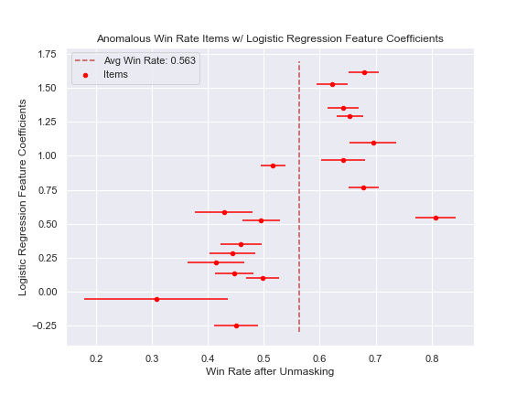
Machine Learning: Compare to my Statistics

Slide 62
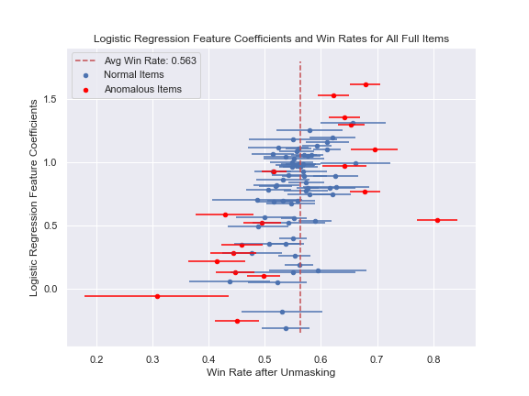
Machine Learning: Compare to my Statistics

Slide 63
Machine Learning: Bias Problems?
The 0 column
Good for predicting a game’s outcome
Not technically an item
The Logistic Regression intercept
With an intercept, feeding the model all 0s doesn’t return 50/50
It should
VS

Slide 64
Machine Learning: Logistic Regression 2.0
Remove the 0 column from the data
Don’t fit an intercept
Training accuracy: 0.898
Test accuracy: 0.881
Only slightly worse at predicting match results
Feature coefficients should be slightly more useful now
Grid search yielded the default hyperparameters

Slide 65
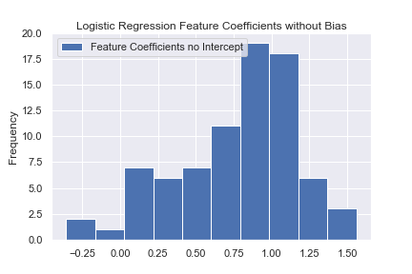
Machine Learning: Logistic Regression 2.0
How do the feature coefficients compare to the first LR?
Very similar

Slide 66
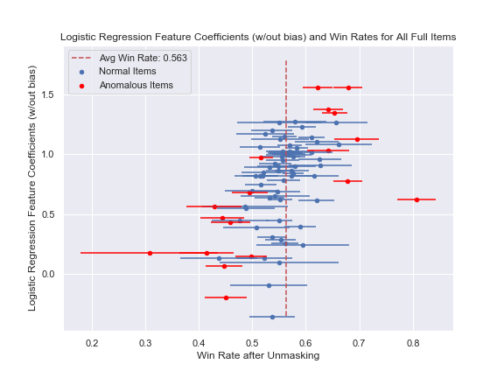
Machine Learning: Compare to my Statistics 2.0
With Intercept and 0 column
Without Intercept and 0 column

Slide 67
Outline
Crash Course: League of Legends
Problem Statement
Data
Statistics
Machine Learning
Conclusions

Slide 68
What should I recommend?
Statistical analyses
Avg win rate was > 1.96 std dev’s away from the item’s win rate
Logistic Regression
Top 10 / Bottom 10 Feature Coefficients
Unusually high / low impact on the game’s result
That intersection – strong rebalance recommendation
Their union minus the intersection – moderate rebalance recommendation

Slide 69





Recommendations: Items that are Too Weak
Flagged by both analyses
Runic Echoes (blue)
Remnant of the Ascended
Warrior (blue)
Manamune
Cinderhulk (red)
Flagged by one of the analyses
Logistic Regression
Bloodrazor (red)
Wit’s End
Mikael’s Crucible
Hextech GLP-800
Athene’s Unholy Grail
Win Rate Statistics
Adaptive Helm
Hextech Protobelt-01
Trinity Force
Muramana
Cinderhulk (blue)

Slide 70

Recommendations: Items that are Too Weak 2.0
Flagged by both analyses
Runic Echoes (blue)
Remnant of the Ascended
Warrior (blue)
Manamune
Cinderhulk (red)
Flagged by one of the analyses
Logistic Regression
Bloodrazor (red)
Wit’s End
Mikael’s Crucible
Hextech GLP-800
Athene’s Unholy Grail
Win Rate Statistics
Adaptive Helm
Hextech Protobelt-01
Trinity Force
Muramana
Cinderhulk (blue)

Slide 71




Recommendations: Items that are Too Strong
Flagged by both analyses
Rabadon’s Deathcap
Liandry’s Torment
Sterak’s Gage
Infinity Edge
Flagged by one of the analyses
Logistic Regression
Mortal Reminder
Edge of Night
Gargoyle Stoneplate
Guinsoo’s Rageblade
Thornmail
Frozen Mallet
Win Rate Statistics
Statikk Shiv
Zeke’s Convergence
Mejai’s Soulstealer
Guardian Angel

Slide 72
Recommendations: Items that are Too Strong 2.0
Flagged by both analyses
Rabadon’s Deathcap
Liandry’s Torment
Sterak’s Gage
Infinity Edge
Flagged by one of the analyses
Logistic Regression
Mortal Reminder
Edge of Night
Gargoyle Stoneplate
Guinsoo’s Rageblade
Thornmail
Frozen Mallet
Win Rate Statistics
Statikk Shiv
Zeke’s Convergence
Mejai’s Soulstealer
Guardian Angel

Slide 73
Recommendations: Final
Make stronger
Runic Echoes (blue)
Remnant of the Ascended
Manamune
Cinderhulk (red)
Make weaker
Rabadon’s Deathcap
Liandry’s Torment
Sterak’s Gage
Infinity Edge
Consider making stronger
Wit’s End
Mikael’s Crucible
Hextech GLP-800
Athene’s Unholy Grail
Adaptive Helm
Hextech Protobelt-01
Trinity Force
Muramana
Consider making weaker
Mortal Reminder
Edge of Night
Gargoyle Stoneplate
Guinsoo’s Rageblade
Statikk Shiv
Zeke’s Convergence
Mejai’s Soulstealer
Guardian Angel
Notes:
Data from patch 8.22
Remnant was buffed in patch 8.23
Zeke’s Convergence was nerfed in 8.24b

Slide 74
Room for Improvement
Try to change items based on popularity (pick rate)
Timing data
Consider the meta
Model as a whole should consider champions as well
This adds enormously to the work I would need to do
Different ML models?

Slide 75
Conclusions
Wanted to find a way to recommend item changes
Statistical analysis of win rates
Machine learning models to find high- and low- impact items
Found 4 items to buff, 4 items to nerf

Slide 76
Backup Slides

Slide 77
Wrinkle About Tags
Original Tag List
u'[Fighter, Assassin]’
Regex
df['tags'] = [re.findall('[A-Za-z]\w*', df.loc[champion, 'tags’])
for champion in df.index]
Final Tag List
[u'Fighter', u'Assassin']

Slide 78
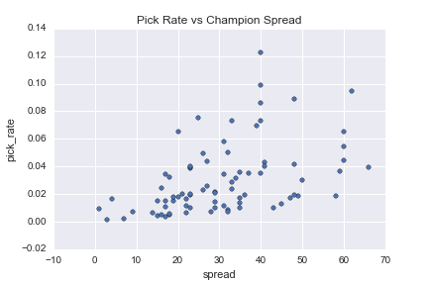
Item Stats: Champion Spread
How many unique champions buy an item
141 champions total
Low spread = low flexibility
High spread = excessive flexibility
Notes:
Change the first plot here, too

Slide 79
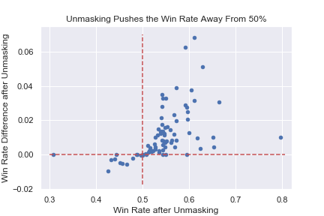
Statistics: Unmasked Win Rates
I figured that this masking pushes win rates towards 0.50
Unmasking pushes win rates away from 0.50

Slide 80
Aggregate by Item Tags
Items can be grouped into sets based on the bonuses they give
Example tags:
Damage
SpellDamage
Health
Armor
SpellBlock
AttackSpeed

Slide 81
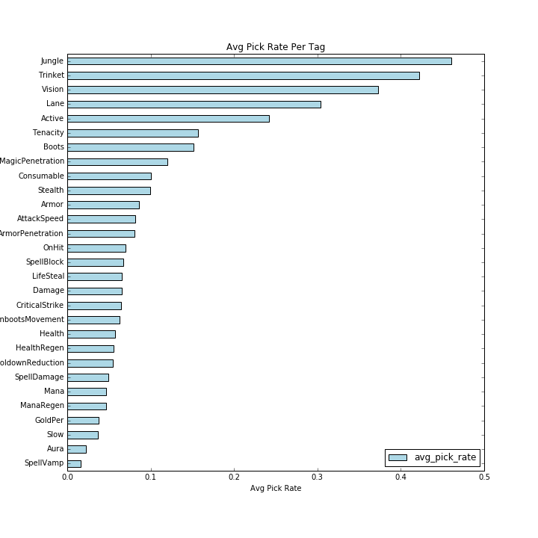
Pick Rate vs Tag

Slide 82
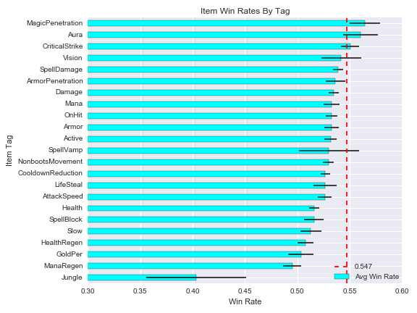
Win Rate Per Tag
Average win rate for all items of the tag
Std deviation of the win rate for the tags’ items

Slide 83
Summoner Spells (Smite Specifically)
Flash
Ghost
Heal
Ignite
Teleport
Exhaust
Smite
Cleanse
Barrier
Smite is required for Junglers
Jungle items cannot be purchased if the summoner does not have smite
Jungle items grant bonus gold and experience when jungle monsters are slain
Jungling is not viable without a jungle item

Slide 84
Statistics: Jungle Items
My initial thought was that the avg win rate would be 0.50
Focusing on full items, it made sense that most win rates would be higher than 0.50
Jungle items do not follow this trend, but instead sit around 0.50
One player per team builds a jungle item, almost always first
Incomplete jungle items are uncommon.

Slide 85
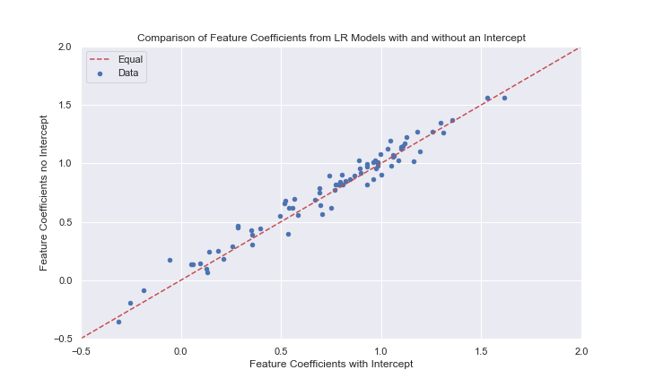
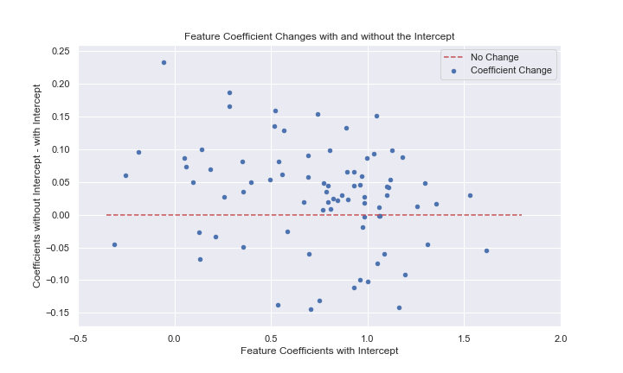
Machine Learning: Logistic Regression 2.0
How do the feature coefficients compare to the first LR?
Very similar
Notes:
This plot compares the feature coefficients from Logistic Regression models fit with and without an intercept.
If a dot is on the red line, then the coefficient didn't change from one model to the other.
If a dot is below the red line, then the coefficient decreased from the model with the intercept to the model without.
If a dot is above the red line, then the coefficient increased from the model with the intercept to the model without.
It seems like most coefficients went up a bit.

Slide 86
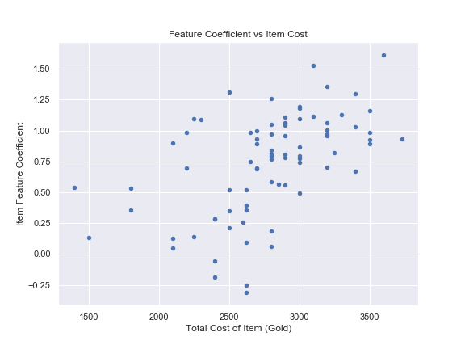
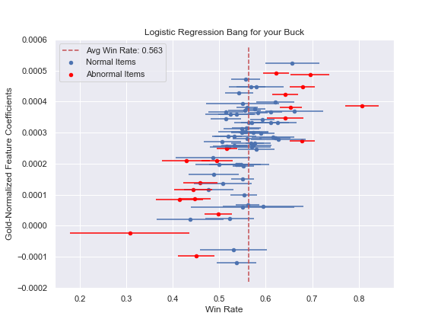
Machine Learning: Item Costs
Stronger / more expensive items should have higher impact
Normalize feature coefficients by item cost

